Slide 1
Lesson 2
Data Types, Conditionals, Loops
Python Intermediate

Slide 2
Guidelines for today
Hands-on work, do it with me!
Use VSCode or your favorite IDE.
Ask ask ask!
Notes:
We will be writing code together in class.
Use whatever IDE you are comfortable with. We use VSCode.
Ask questions!
.PY files will be uploaded later tonight which will reinforce what we learned this evening and have additional exercises for you to work on.

Slide 3
Topics
Primitive types
int, float
string
bool
Conditions
Loops
Notes:
These are some of the fundamental building blocks that make up the Python language.
You will use some combination of these in just about every program you write.

Slide 4
Types

Slide 5
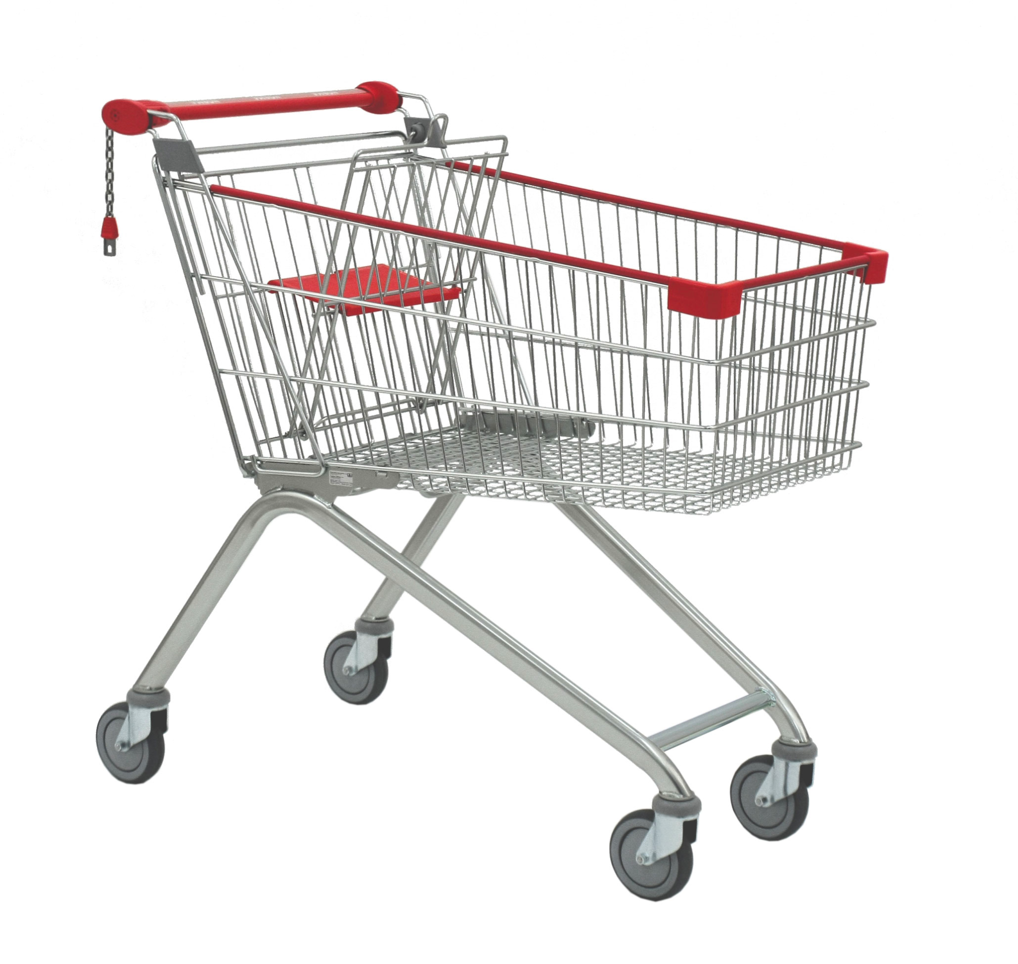




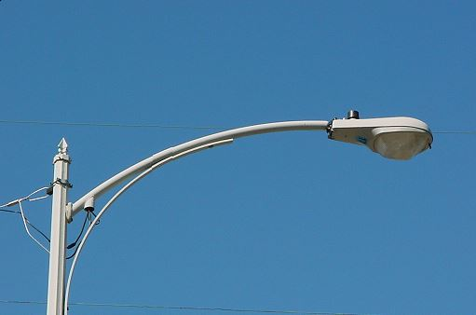
Types In Real Life
Notes:
Every object we encounter has a type. A type helps us identify an object as well as differentiate between different objects.

Slide 6
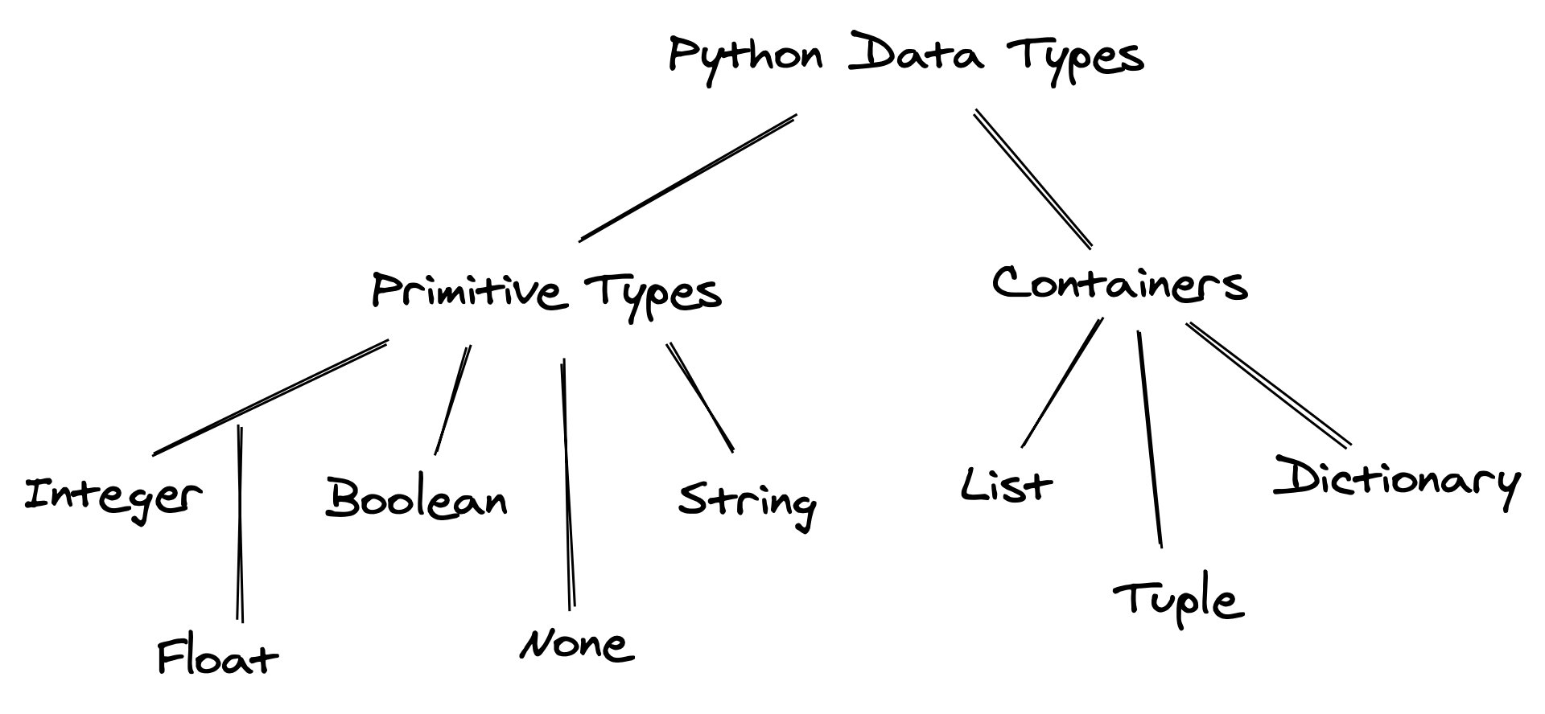
Python provides several built-in types natively
Today we are going to focus on
primitive types!
Image source:
https://jovian.com/aakashns/python-variables-and-data-types
Notes:
Q: Why do we have all these different data types in coding?
Same reason we have different types in real life.
Categorizes information and provides differentiation
Defines attributes about the object
Defines the operations that the object can perform
For example, a shopping cart cannot open the garage door.
Likewise, a cat does not not have wheels.
There is no instruction in Python to declare a variable’s type.
In other languages, declaring a variable means explicitly identifying its type.
In Python, we define a variable’s type by what data we store in it.
Today we’re focusing on the Primitive Types. The Containers (or Collections) will be covered in a later lesson.

Slide 7
Integers int
Object of type int = integer numbers
0
1
156
-13
Assignment, sets the type of the variable: int
x = 15
y = max(2,5)
Basic operations (e.g., addition) already implemented
7+3
15-6
(1+2)*3
max(2,5)
Remember the type() function!
type(15)
type(x)
Notes:
An integer is any whole number, either positive or negative.
When we assign data to a variable, Python infers it’s type.
Operations for integers are already defined in Python.
There are also built-in functions like min() and max().
To identify the type of a variable, use the type() function.

Slide 8
Floating point float
Object of type float = decimal numbers
0.0
1.
.3
-13.6
Assignment, sets the type of the variable: float
x = 15.
y = max(.2,.5)
Basic operations (e.g., addition) already implemented
7.+3.
.5-6.2
(1.+2.)*3.
max(.2,.5)
int and float can be mixed in numeric
expressions
3 + .2
max(2,.5)
Notes:
A float, or floating point, number is any number, either positive or negative with a fractional portion, even if it is 0.
Operations for floats are already defined in Python.
There are also built-in functions like min() and max().
To identify the type of a variable, use the type() function.

Slide 9
Type Conversions
An operation that converts data from one type to another.
Can happen automatically.
Built-in functions int(), float(), and str() allow us to convert between numerics and strings
NOTE: it is possible to introduce mathematical errors with type conversion, these can be hard to track down.
Notes:
Type conversion: occurs when combining an int and a float in a calculation.
Type conversions can occur automatically when mixing data of different types.
The built-in functions int(), float() and str() allow us to explicitly convert data between types.
When mixing integers and floats, Python will take the most conservative path to prevent losing data.
When combining an int and a float, the result will be a float.
Type the following code in the console / terminal to see the possible loss of data.
>>> i = 42
>>> type(i)
<class 'int'>
>>> j = float(99) + int(100)
>>> print(j)
199.0
>>> type(j)
<class 'float'>
>>> x = 22.9
>>> y = 1046
>>> z = int(x + y)
>>> print(z)
1068 <<<--- Did we want to lose the fractional part?
>>> type(z)
<class 'int'>

Slide 10
Strings str
Object of type str = text
"Ciao"
"&$#*#$("
""
"""Numbers as text: 12"""
some_str = "This is a string"
Assignment:
Many string operations are already implemented
len("ciao")
"banana".count("n")
We can produce strings from other values
str(14)
str(6. / 2)
Pick one approach and remain consistent throughout your code.
Can use single or double quotes - don’t mix them!
'' "" ''' ''' """ """
Notes:
Any characters within '' or "" or ''' ''' or """ """ result in a string.
The starting and ending quote must be the same.
Single quotes: 'allows embedded "double" quotes'
Double quotes: "allows embedded 'single' quotes" (my preference to support contractions like "don't" within a string)
When we assign data to a variable, Python infers it’s type.
Operations and functions for strings are already defined in Python.
To identify the type of a variable, use the type() function.
TIP: When using quotes, pick the one you prefer or the one that is used in the existing code you are modifying, and remain consistent.
Let’s get some input from the user and display it back:
Open VSCode if it’s not already open.
Create a new .py file.
Write the following code and then run it:
name = input("What is your name: ")
nickname = input("What is your nickname: ")
color = input("What is your favorite color: ")
print(name, "--", nickname, "--", color)

Slide 11
Strings str
The input() function returns everything as a string.
If we want to perform mathematical calculations, we need to convert what input() gives us to valid numbers.
Use the int() and float() functions to convert to numeric.
If we don’t convert the input, we get an interesting result. Let’s find out!
Notes:
Comment out the previous code you typed into the .py file and then enter the following code. Just enter the blue code first:
user_num1 = input("Enter a number: ")
first_number = int(user_num1)
user_num2 = input("Enter another number: ")
second_number = int(user_num2)
print(user_num1 + user_num2)
print(first_number + second_number)
The blue code results in a string operation called “concatenation”. It merges the two string together into one string.
Now add in the red code and re-run it.
Modify the code to compress it down to fewer lines:
first_number = int(input("Enter a number: "))
second_number = int(input("Enter another number: "))
print(first_number + second_number)

Slide 12
Truth values bool
Object of type bool = true or false
True
False
bool(0) ➪ False
bool(1) ➪ True
bool(0.0) ➪ False
bool(0.1) ➪ True
bool("") ➪ False
bool("a string") ➪ True
With the bool() function, we can produce booleans from other objects
bool(0)
bool(.5)
bool("ciao!")
Output of comparison operators
2 == 5
2 != 5
.2 < .5
Logical operators already implemented
and
or
not
Notes:
True and False are proper keywords in Python.
Calling the bool() function with data results in either True or False. How to remember boolean results of data:
"", 0, and 0.0 = False.
Everything else = True
Comparison Operators: ==, !=, <, >, <=, >=. These all result in either True or False.
Logical Operators and, or, and not evaluate an expression for True or False.
The and and or operators are used with multiple expressions.
Enter these commands in the Python Console:
>>> 6 < 2
False
>>> 5 > 9
False
>>> 6 <= 6
True
>>> 9 >= -9
True
>>> 10 != 10
False
>>> 10 != 4
True
>>> 15 == 15
True
>>> 5 == 5 and 6 < 10
True
>>> 5 == 5 and 6 > 10
False
>>> 5 == 5 or 6 < 10
True
>>> 5 == 5 or 6 > 10
True
>>> 5 != 5 or 6 > 10
False

Slide 13
Conditions
if..elif..else

Slide 14
Conditions
Often we want to run a piece of code only if certain conditions are met.
We can do that using if statements!
if <test1>:
<code if test1 is true>
elif <test2>:
<code if test2 is true>
else:
<code if test1 AND
test2 are both False>
if x > 0:
print("x is positive")
elif x == 0:
print("x is 0")
else:
print("x is negative")
First example of a compound statement!
Indentation is key!
Colons are key!
Notes:
The if and the elif parts of the statement require a condition to test.
The else part does not have a condition to test.
Indentation and colons tell Python what code belongs inside of the if statement and what code doesn’t. VERY IMPORTANT!!

Slide 15
Let’s Try This Together
Notes:
Let’s write an if…then statement:
answer = input("Do you like ice cream (Y/N): ")
if answer == "Y":
print("Great, let's go get some!")
else:
print("Aww, too bad. I'm really craving some ice cream now!")
Run the program twice. The first time enter Y and the second time enter N:
Try entering anything else besides Y or N. What happens?
Let’s try an if…elif…else statement next:
number = int(input("Enter a number: "))
if number < 0:
print("You entered a negative number.")
elif number == 0:
print("You entered 0.")
else:
print("You entered a positive number.")
And run it three times, once with 0, once with a negative number, and once with a positive number:

Slide 16
Conditions
If we have multiple conditions to test together, we use and or or.
and: All conditions MUST BE True in order for the complete evaluation to be True. If any condition is False, the entire evaluation is False.
or: All conditions MUST BE False in order for the complete evaluation to be False. If any condition is True, the entire evaluation is True.
Let’s try this with code.
Notes:
Type in the following pieces of code to demonstrate and and or:
x = int(input("Enter a number: ")
if x >= 0 and x < 10:
print("x is a single-digit positive number")
elif x >= 10:
print("x is a multi-digit positive number")
else:
print("x is a negative number")
answer = input("Yes or No?: ")
if answer == "YES" or answer == "Yes" or answer == "yes":
print("You answered YES!")
else:
print("You answered NO!")
There is an easier way to handle the second piece of code by using string functions.
Challenge, try to use a string function so you don’t have to check all the different ways a user can type in the word “yes”.

Slide 17
Loops
while, for

Slide 18
while loops
Loops allow us to execute the same piece of code several times in a row.
How many times or when the looping stops depends on the kind of loop.
while loops run a piece of code as long as a certain condition is true. The test looks the same as it did with the if statement.
while <test>:
<code to loop>
x = 0
while x < 10:
print("x is", x)
x = x + 1
Careful!!!
The code might never run or run indefinitely! If it runs indefinitely it’s known as an infinite loop.
Notes:
The <test> format is the same as in the if statement.
The <code in loop> may never run - dead code.
The <code in loop> may run forever - infinite loop.
We want to display the numbers 1 through 10:
current_number = 1
max_printed_number = 10
while current_number <= max_printed_number:
print("Printing number", current_number)
current_number += 1
Printing number 1
Printing number 2
Printing number 3
Printing number 4
Printing number 5
Printing number 6
Printing number 7
Printing number 8
Printing number 9
Printing number 10
Let’s change current_number to a couple of different values. First, change it to 20 and run it. Then change it to -10 and run it.
20: nothing happens because 20 is greater than 10 - dead code
-10: runs from -10 to 10, so we get more output.
And if you remove the line current_number += 1 we get an infinite loop

Slide 19
for loops: introduction to range
range is built into Python and it counts for us. We tell it where to start, where to end, and what increment we want, and it will do all the counting.
Minimally tell it to end at a certain value:
range(10) # Count from 0 up to but not including 10.
Tell it the starting value:
range(1,10) # Count from 1 up to but not including 10.
Tell it the increment or step value:
range(1,10,2) # Count from 1 up to but not including
# 10 by 2 (1, 3, 5, 7, 9).
Notes:
range can take different number of arguments depending on what looping constraints we have.

Slide 20
for loops
for loops run a piece of code for a fixed number of times.
for <variable> in range(<number of loops plus one>):
<code to loop>
for counter in range(10):
print("Counter is", counter)
Code is executed
10 times!
Notes:
for loops run a fixed number of times whereas while loops run until a condition is no longer met.
range can be used with a for loop to assist in managing a counter.
Remember that the stop value provided to range ends the for loop rather than executing a final time.
for counter in range(10):
print(counter)
0
1
2
3
4
5
6
7
8
9
for counter in range(2, 10):
print(counter)
2
3
4
5
6
7
8
9
for counter in range(0, 30, 3):
print(counter)
0
3
6
9
12
15
18
21
24
27
Here’s a neat example of using range with negative numbers. Using the string we had earlier "strings are zero-based" let’s run this loop over it:
my_str = "Strings are zero-based"
for x in range(-10, 10, 2):
print("X:", x, my_str[x])
X: -10 z
X: -8 r
X: -6 -
X: -4 a
X: -2 e
X: 0 S
X: 2 r
X: 4 n
X: 6 s
X: 8 a
The negative numbers coming from range tell Python to index from the end of the string instead of the beginning.

Slide 21
Let’s Try This Together
Notes:
Let’s write for loop that relies on user input. We will ask the user for a whole number:
If they entered a negative number we will respond with an error that negative numbers aren’t permitted.
If they enter a 0, we will print 0.
If they enter a positive number, we will provide a sum of those numbers
user_input = int(input("Enter any whole number: "))
if user_input < 0:
print("Negative numbers aren't permitted.")
elif user_input == 0:
print(0)
else:
result = 0
for x in range(0, user_input+1):
result += x
print(result)
Run the code three times, once with a negative number, once with 0, and once with a positive number.

Slide 22
The break keyword
Sometimes you may actually want to create an infinite loop.
For example, allow the user to keep trying until they either provide the correct response or wish to end the program.
In these cases, we can force the loop to stop by using the break keyword.
Typically we will have a test in the loop that checks for a specific condition. When that check results in True, we use break to end the loop.
Notes:
Enter the following code in your .py file:
# Create an infinite loop (!)
while True:
num_one = int(input("Enter a number: "))
num_two = int(input("Enter another number: "))
print (num_one, "/", num_two, "=", num_one / num_two)
response = input("Try again? (Y/N): ")
if response == "n" or response == "N":
break

Slide 23
Summary
This lesson covered some fundamental building blocks of Python:
What is a type and what set of types are the primitive types
Numeric types: int and float
Built-in data conversion functions: int(), float() and str()
Strings and converting input data into numerics
Booleans and the bool() function
The if…elif…else statement, testing conditions, and and or
The while loop and for loop
Introduction to range
The break keyword

Slide 24
Any question?

Slide 25
Your turn now!
Open the file 6_FinalExercise.py!
Notes:
Play around with this one and learn about different string functions.

Slide 26
Thank You!

Slide 27
Strings str
The length of a string can be retrieved with the len() function.
Strings are a collection of characters.
The size of string str_info is found by calling len(str_info)
Indexes of str_info go from 0 to len(str_info)-1
Access each character by using an integer - index.
Collections including strings are zero-based, the indexes start from 0.
str_info = "Strings are zero-based"
0
0
0
0
0
0
0
0
0
0
1
1
1
1
1
1
1
1
1
1
2
2
0
1
2
3
4
5
6
7
8
9
0
1
2
3
4
5
6
7
8
9
0
1
S
t
r
i
n
g
s
a
r
e
z
e
r
o
-
b
a
s
e
d
print(len(str_info)) # Result will be 22
print(str_info[0]) # Result will be ‘S’
print(str_info[14]) # Result will be ‘r’
print(str_info[-5]) # Result will be ‘b’ len(str_info)-5
Notes:
You’re going to see this again next week when covering Lists and other collections.
To get the length of a string, we use the len() function.
A string is a collection of characters.
Because of this, we can visit individual characters that are within a string.
We do this by using an index, which is an integer that refers to which character we’re interested in.
Strings use 0-based indexing. This means that the indexes for the characters start at 0 and end at len()-1.
This can be a source for errors, especially when using invalid index values.

Slide 28
Let’s Try This Together
Notes:
For this last example we will use indexing to get to individual characters in a string. Type in the following code and run it:
my_str = "This is a string of text"
print(len(my_str))
print(my_str[0])
print(my_str[15])
print(my_str[-2])
print(my_str[-10])
# print(my_str[24])
# print(my_str[-1000])
Uncomment the last two lines to generate an error.

Slide 29
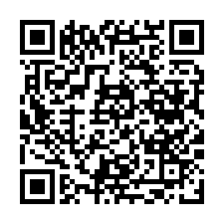
Before you go…
Please take 2 minutes to give us feedback on today’s lesson.
This feedback is anonymous and only seen by the DCP team!

